Slide 1
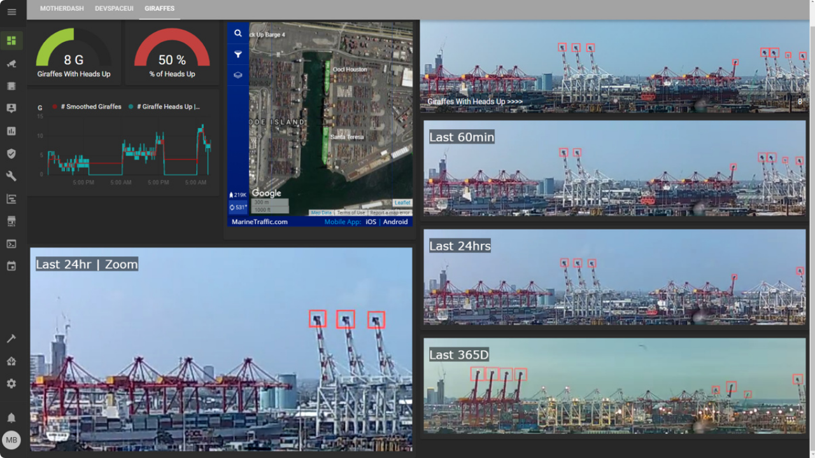


Motion-Activated
Camera System
Applications of ICT (CS-117)
Department of Aerospace Engineering, SMME, NUST
Group Members:
Danyal Hassan
Eisa Hassan
Abdul Moeed

Slide 2


The Challenge & The Solution
The Problem
Our Solution
Continuous video recording generates massive amounts of redundant data. This leads to inefficient storage usage, increased power consumption, and significant difficulty in reviewing footage to find critical events.
An intelligent Motion-Activated Recording System using Python and OpenCV. It continuously monitors a live feed but only records when meaningful activity is detected, preserving context through smart buffering.

Slide 3




System Architecture
Idle & Buffer
Recording
Continuous monitoring with rolling deque buffer
Pre-event + Active Event + Post-event saved
Initialization
Detection
Camera setup & Reference frame capture
MOG2 Algorithm identifies motion

Slide 4


Core Logic: Background Subtraction
We implemented the MOG2 algorithm for robust detection.
Why MOG2? It is significantly faster and more memory-efficient than KNN (K-Nearest Neighbors).
Shadow Detection: Unlike simple subtraction, MOG2 can detect shadows, preventing false positives from lighting changes.
Alternatives: GMG (too heavy), CNT (less robust).

Slide 5






Optimized Buffering with Deque
The Library
Efficiency
Context Preservation
We utilized Python's collections library to implement a deque (Double-Ended Queue) for our frame buffer.
Deque provides time complexity for appends and pops from both ends, making it far superior to standard lists ( ).
This allows us to maintain a "rolling window" of the last few seconds of video, ensuring we capture the moment before motion starts.

Slide 6


Implementation
The system is built on Python using the OpenCV library for image processing.
Key Components:
- Frame subtraction loop
- Contour detection (filtering small movements)
- Uses Deque data structure for buffer
The code handles lighting anomalies via threshold tuning and manages storage automatically.

Slide 7



Sustainability & Impact
Reduced Storage
Energy Efficient
Cost Effective
Saves only meaningful events, drastically reducing hard drive usage.
Less data writing means lower power consumption for storage servers.
Built on open-source software, making surveillance accessible.

Slide 8
Conclusion
This project successfully demonstrates how ICT tools can solve real-world engineering problems. By integrating MOG2 algorithms with deque-based buffering, we achieved a surveillance system that is efficient, reliable, and sustainable.

Slide 9
Questions?
Thank you for your attention.

